Slide 1
Introduction
Slides adapted from Larry Peterson and B. Farouzan
Outline
  Applications and Features
  Statistical Multiplexing
  Inter-Process Communication
  Network Architecture
  Performance Metrics
  Implementation Issues
Reading: Chapter 1
MU CS 4850/7850
Notes:
High level issues of network system

Slide 2
What’s a Network: Key Features
Providing certain services
  transport goods, mail, information or data
Shared resources
  used by many users, often concurrently
Basic building blocks
  nodes (active entities): process and transfer goods/data
  links (passive medium): passive “carrier” of goods/data
Typically “multi-hop”
  two “end points” cannot directly reach each other
  need other nodes/entities to relay
MU CS 4850/7850

Slide 3





What’s a Network: “Nuts and Bolts” View
network edge: millions of end-system devices:
  pc’s workstations, servers
  PDA’s, phones, toasters
  running network apps
network core: routers, switches forwarding data
  packets: packet switching
  calls: circuit switching
communication links
  fiber, copper, radio, …
  Point-to-point or multiple access
router
workstation
server
mobile
local net
regional net
company
net
MU CS 4850/7850

Slide 4
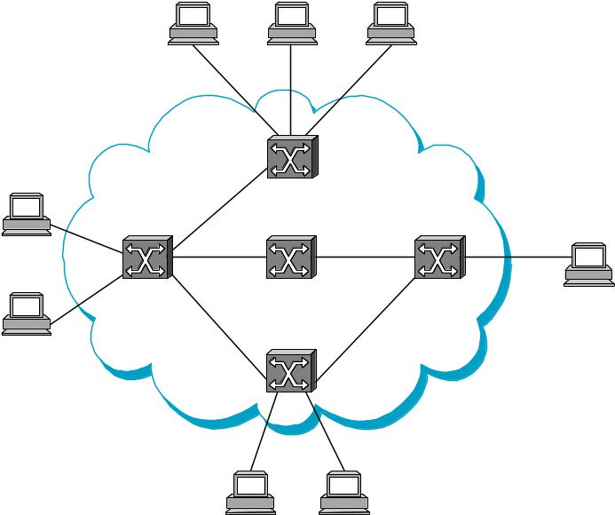
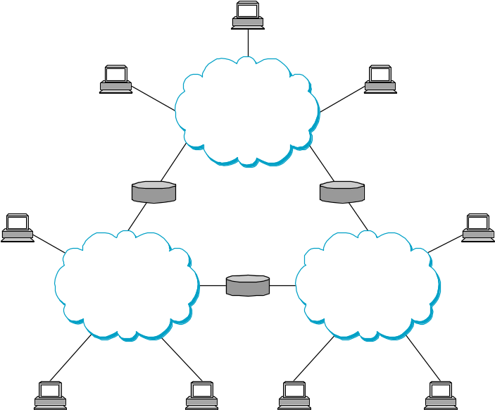
Switched Networks
A network can be defined recursively as...
  two or more nodes connected by a link, or
  two or more networks connected by a node
MU CS 4850/7850

Slide 5
Brief History of the Internet
70’s: started as a research project, 56 kbps, < 100 computers
80-83: ARPANET and MILNET split,
85-86: NSF builds NSFNET as backbone, links 6 Supercomputer centers, 1.5 Mbps, 10,000 computers
87-90: link regional networks, NSI (NASA), ESNet(DOE), DARTnet, TWBNet (DARPA), 100,000 computers
90-92: NSFNET moves to 45 Mbps, 16 mid-level networks
94: NSF backbone dismantled, multiple private backbones
Today: backbones run at >10 Gbps, >600 millions computers in >190 countries
MU CS 4850/7850
Notes:
World population: ~7 billion; Internet users: 2 billions
MILNET (Military Network)
ARPANET (Advanced Research Projects Agency Network)
NASA Science Internet (NSI)
, Energy Sciences Network (ESnet)
DARTNet (DARPA Research Testbed network).
Wideband Packet Satellite Network (WBNET)

Slide 6
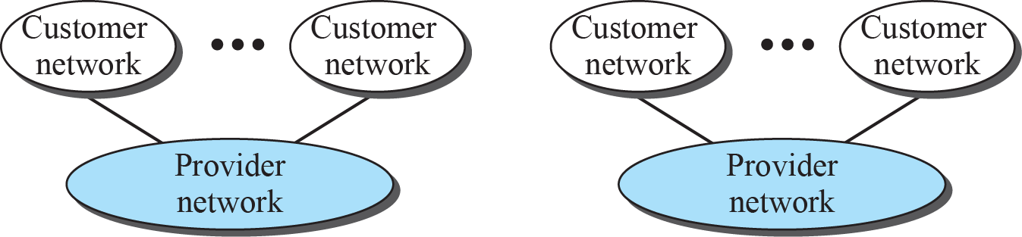
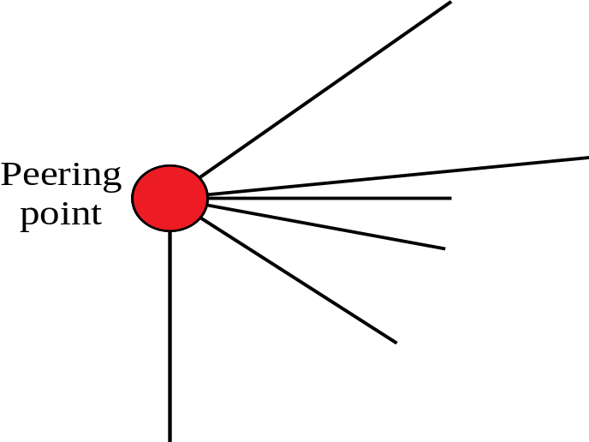




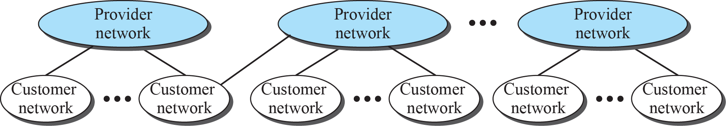
The Internet today
Spring 2016
CMP_SC 4850/7850

Slide 7
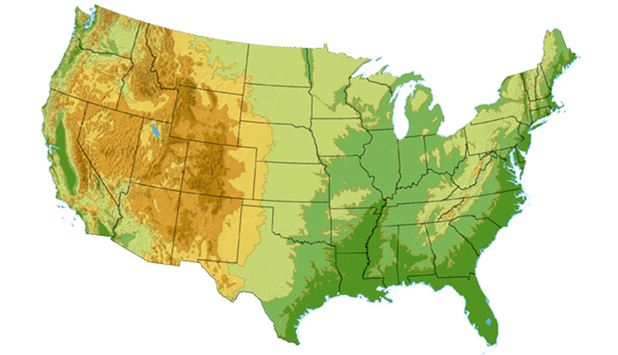

Sprint
Network
Legend
DS3
OC3
OC12
OC48
45 Mbps
155 Mbps
622 Mbps
2.45 Gbps
Seattle
Click here for a closer look at the
Sprint network in Washington state
Click here for
a closer look
at the Sprint
network on the
East Coast
Tacoma
Stockton
New York
Cheyenne
Chicago
Pennsauken
Relay
San Jose
Roachdale
Wash. DC
Kansas City
Click here for
a closer look
at the Sprint
network in
Northern
California
Anaheim
Atlanta
Fort Worth
Pearl City in Hawaii is
a future network location
Orlando
MU CS 4850/7850
Notes:
DS3? Digital Signal 3 (DS3) (T-3 line), 45 Mbps
OC3? 155 Mbps

Slide 8
Strategies
Circuit switching: carry bit streams
  original telephone network
Packet switching: store-and-forward messages
  Internet
MU CS 4850/7850

Slide 9
Addressing, Routing, and Forwarding
Address: byte-string that identifies a node
  usually unique
  What other properties?
Types of addresses
  unicast: node-specific
  broadcast: all nodes on the network
  multicast: some subset of nodes on the network
Routing: process to determine which path a packet will take through a network to reach its destination
Forwarding: Operation to send an incoming packet to the correct switch/router output
MU CS 4850/7850

Slide 10
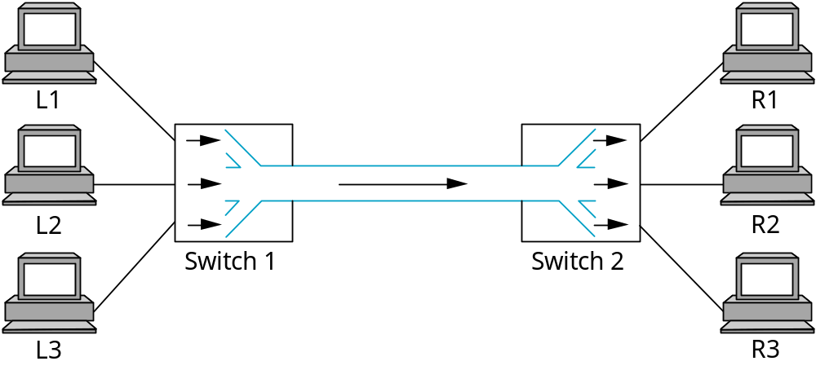
Multiplexing
Synchronous Time-Division Multiplexing (STDM)
Frequency-Division Multiplexing (FDM)
  E.g., TV channels
MU CS 4850/7850

Slide 11
Statistical Multiplexing
Used in Internet
On-demand time-division
Schedule link on a per-packet basis
Packets from different sources interleaved on link
Buffer packets that are contending for the link
Buffer (queue) overflow is called congestion
■ ■ ■
MU CS 4850/7850

Slide 12
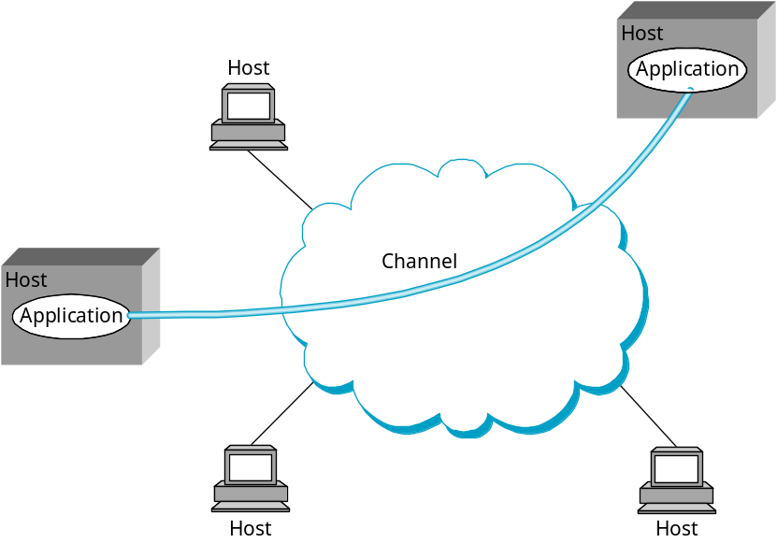
Inter-Process Communication
Turn host-to-host connectivity into process-to-process communication (to support common services).
Fill gap between what applications expect and what the underlying technology provides.
MU CS 4850/7850

Slide 13
IPC Abstractions
Request/Reply
  distributed file systems
  digital libraries (web)
Stream-Based
  video: sequence of frames
    1/4 NTSC = 352x240 pixels
    (352 x 240 x 24)/8=247.5KB
    30 fps = 7500KBps = 60Mbps
  video applications
    on-demand video
    video conferencing
      More demanding
MU CS 4850/7850

Slide 14
What Goes Wrong in the Network?
Bit-level errors (electrical interference)
Packet-level errors (congestion)
Link and node failures
Packets are delayed
Packets are deliver out-of-order
Third parties eavesdrop
MU CS 4850/7850

Slide 15
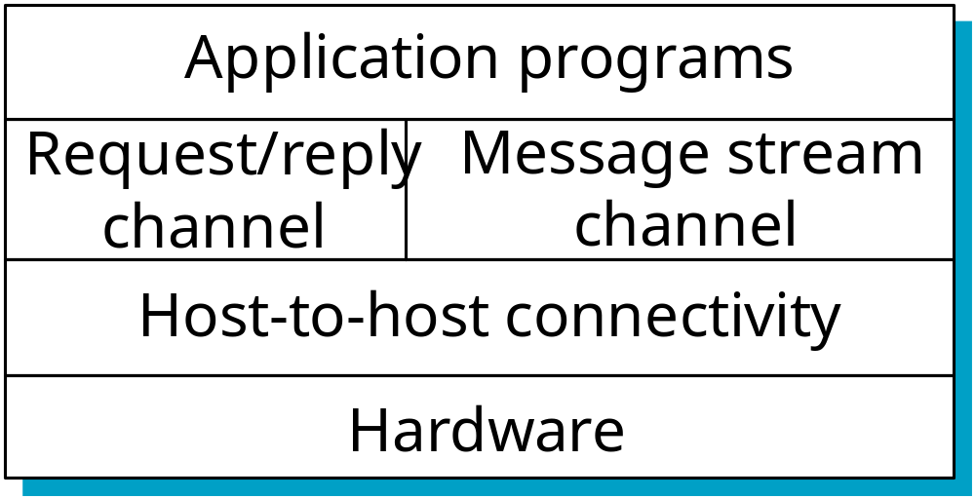
Layering Architecture
Use abstractions to hide complexity
Abstraction naturally lead to layering
Alternative abstractions at each layer
MU CS 4850/7850

Slide 16
Protocols
Building blocks of a network architecture
  protocols define format, order of msgs sent and received among network entities, and actions taken on msg transmission, receipt
Each protocol object has two different interfaces
  service interface: operations on this protocol (e.g., how to get a message)
  peer-to-peer interface: messages exchanged with peer (e.g., definition of message format)
Term “protocol” is overloaded
  specification of peer-to-peer interface
  module that implements this interface
MU CS 4850/7850

Slide 17
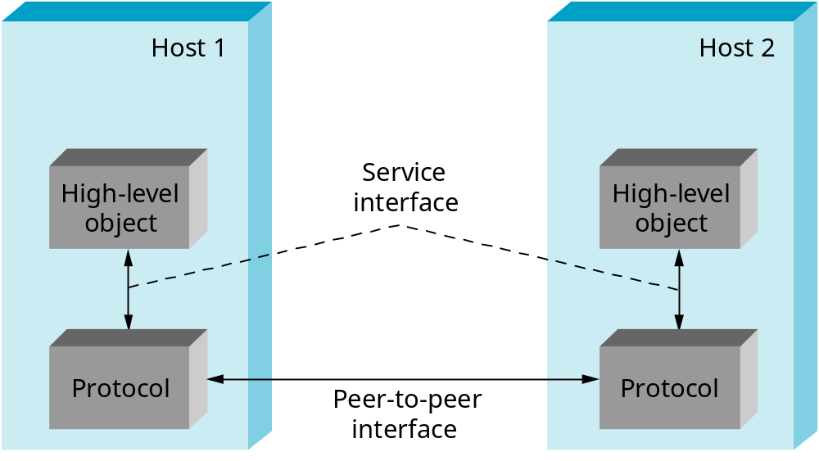
Interfaces
MU CS 4850/7850

Slide 18
TCP/IP protocol suite
Spring 2016
CMP_SC 4850/7850
Application: supporting network applications
  FTP, SMTP, HTTP
Transport: host-host data transfer
  TCP, UDP
Network: routing of datagrams from source to destination
  IP, Routing protocols
Data link: data transfer between neighboring network elements
  PPP, Ethernet
Physical: bits “on the wire”
Application
Application
Layer 5
Transport
Transport
Layer 4
Internet
Network
Layer 3
Hardware Devices
Physical
Layer 1

Slide 19
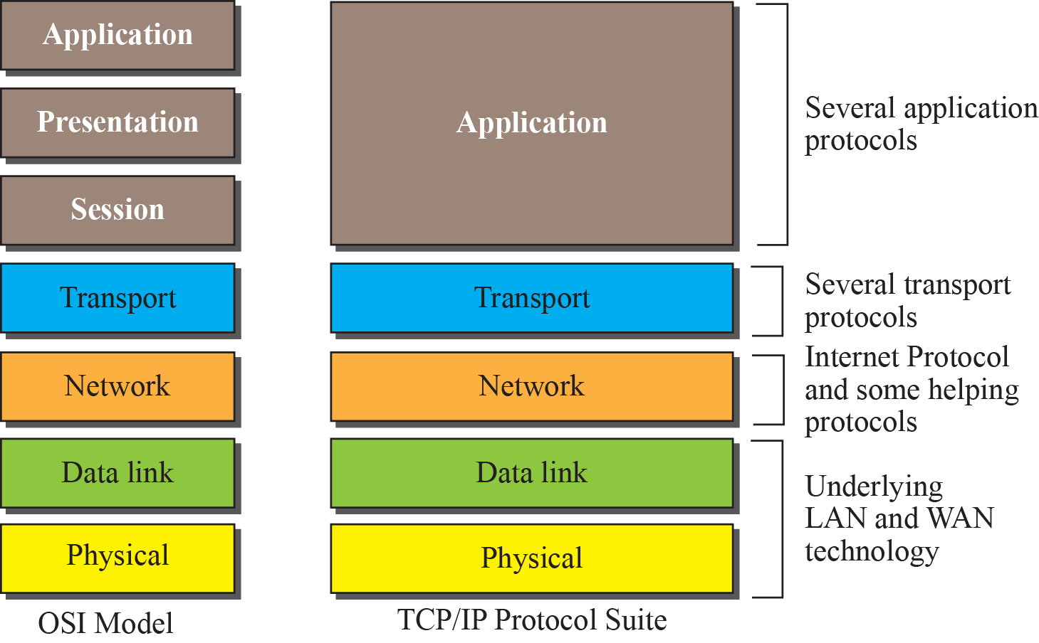
ISO/OSI model vs. TCP/IP
Spring 2016
CMP_SC 4850/7850
e.g., FTP, SMTP, HTTP
(UDP, TCP)
(IP, Routing Protocols)
(PPP, Ethernet, etc)

Slide 20
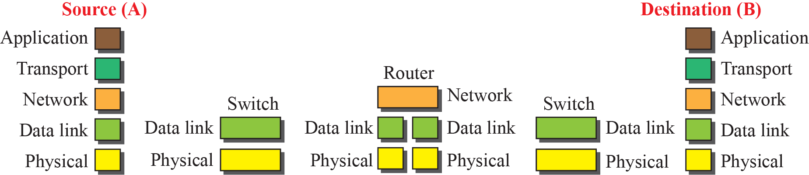

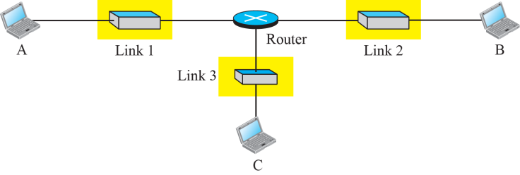
Communication through Internet
Spring 2016
CMP_SC 4850/7850
Switch 1
Switch 2
Switch 3

Slide 21
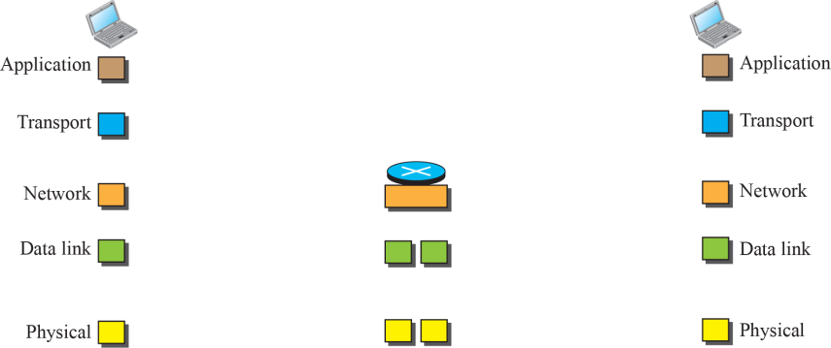

Identical objects between layers in TCP/IP
Spring 2016
CMP_SC 4850/7850
Identical objects (messages)
Identical objects (segment or user datagram)
Identical objects (datagram)
Identical objects (datagram)
Identical objects (frame)
Identical objects (frame)
Identical objects (bits)
Identical objects (bits)

Slide 22
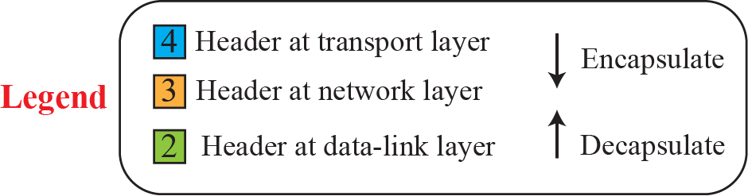



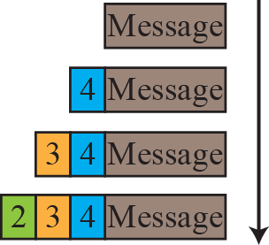

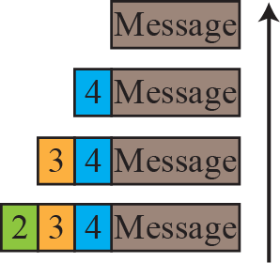
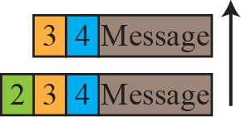
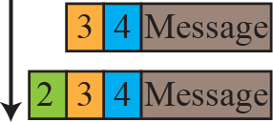
Spring 2016
CMP_SC 4850/7850
Encapsulation (Header/Body)
Notes:
1.#

Slide 23
Internet Architecture
Defined by Internet Engineering Task Force (IETF)
Hourglass Design
Application vs Application Protocol (FTP, HTTP)
FTP
HTTP
NV
TFTP
Transport Layer
TCP
UDP
Internet Layer
IP
NET
1
NET
2
■ ■ ■
NET
n
MU CS 4850/7850

Slide 24
Implications of Hourglass
A single Internet layer module:
Allows all networks to interoperate
  all networks technologies that support IP can exchange packets
Allows all applications to function on all networks
  all applications that can run on IP can use any network
Simultaneous developments above and below IP
MU CS 4850/7850

Slide 25
Network Performance
How long does it take to transmit a data block
  Latency
  over single link
  over a network of routers/switches connected by links
Latency depends on
  Initial time to set up communication (setup time)
  time it takes to put data block on a link (transmit time)
  length of links and link speed (propagation delay)
  delay in a router (queuing delay)
  Latency = setup time + transmit time + propagation delay + queuing delay
Overall network performance
  Throughput = Size-Of-Data-Block / Latency
  Effective Bandwidth

Slide 26
Performance Metrics
Transmit time
  Time it takes to put data block on a link
  Determined by link bandwidth
  Bandwidth
    data transmitted per time unit
    e.g., 10 Mbps (Mega-bit-per-second)
    notation
      KB = 2¹⁰ bytes = 1024 bytes; MB = 2²⁰ bytes = 1048576 bytes
      Mbps = 10⁶ bits per second
  Transmit Time = Data Size / Bandwidth
Propagation Delay
  Determined by length of links and link speed
  Propagation Delay= Distance / c
    c = transmission speed
    c = 2.0 x 10⁸ m/s in fiber; c = 2.3 x 10⁸ m/s in cable
MU CS 4850/7850

Slide 27
Data Size:
Bandwidth:
Size | Bits | Bits in Decimal
1 KB (KiB) | 8 x 2¹⁰ | 8,192
1 MB (MiB) | 8 x 2²⁰ | 8,388,608
1 GB (GiB) | 8 x 2³⁰ | 8,589,934,592
BW | bps | bps in Decimal
1 Kbps | 10³ | 1,000
1 Mbps | 10⁶ | 1,000,000
1 Gbps | 10⁹ | 1,000,000,000

Slide 28
Network Performance
Packet-switched networks
  Network can only handle fixed-sized data packets
    Need to chop data block up into packets and send packets one-by-one
    Latency: total time between sending the first data bit to having received the last data bit
  In some networks, after sending a packet, sender waits for a response from the receiver that that packet was received, before sending the next packet
    Need to wait RTT (Round Trip Time) between sending packets
      RTT = 2 x one-way time (time for data packet + time for response)
    For example, if need to send 10 packets
      Need 9 RTT to send first 9 packets, then 0.5 RTT for last packet to be received -> 9.5 RTT delay

Slide 29
Exercise
Calculate the total time required to transfer a 1.5 MB file, assuming an RTT of 80 ms, a packet size of 1 KB, and an initial 2xRTT of “hand-shaking” before data is sent. The bandwidth is 10 Mbps and data packets can be sent continuously. Assume transfer is completed when last bit of the last packet arrives.
Sol:
  [Setup Time] =
  [Transmit Time] =
  [Propagation] =
  Total Latency =
What is the effective bandwidth (or throughput)?
MU CS 4850/7850

Slide 30
Exercise
Same as before, but after finishing sending each data packet, must wait one RTT before sending the next.
  How does this change the calculation?
  ? in Total Latency -> ? of Effective Bandwidth
  # of packets=
  Total Latency =
Effective Bandwidth
MU CS 4850/7850

Slide 31
Exercise
The link allows infinitely fast transmit, but limits bandwidth such that only 20 packets can be sent per RTT.
  How does this change the problem?
  No Transmit time. Only RTT to account for in the calculation
  1536 packets / 20 packets per RTT = 77 RTT
  77 RTT + 2 RTT(handshaking) + 0.5 RTT (last packet) = 79.5 RTT
  79.5 x 0.08s = 6.36s
Effective Bandwidth
  (1.5 x (2²⁰) x 8)/6.36 bps = 1,978,445.28 bps
  = 1.978 Mbps
MU CS 4850/7850

Slide 32
Exercise
Consider a point-to-point link 50 km in length. At what bandwidth would propagation delay (at a speed of 2×10⁸ m/s) equal transmit delay for 100-byte packets? What about 512-byte packets?
Answer:
  100-byte packets: 3.2 Mbps
  512-byte packets: 16.384 Mbps
MU CS 4850/7850

Slide 33
Network Performance Revisited
A
S1
B
Calculate the total time required to transfer a 1.5 MB file from host A to host B through switch S1. The delay on link A -> S1 is 25ms and the delay on link S1 -> B is 15ms. A packet size of 1 KB is used, and an initial 2xRTT of “hand-shaking” before data is sent occurs (RTT does not include switch delay). The bandwidth is 10 Mbps on each link. S1 begins retransmitting each data packet 10ms after receiving it. Assume host A sends packets continuously and transfer is completed when last packet arrives at B.
MU CS4850/7850

Slide 34
Network Performance Revisited
10 ms
A
25 ms
S1
15 ms
B
10 Mbps
10 Mbps
Latency = Setup Time + Transmit + Propagation +
Queuing Delay
RTT
=
# of packets
=
MU CS4850/7850

Slide 35
Network Performance Revisited
10 ms
A
25 ms
S1
15 ms
B
10 Mbps
10 Mbps
Latency = Setup Time + Transmit + Propagation +
Queuing Delay
Setup Time
2xRTT Handshaking =
Transmit
=
We have two transmissions now at host A and S1, so we need to multiply that number by 2
=
MU CS4850/7850

Slide 36
Network Performance Revisited
10 ms
A
25 ms
S1
15 ms
B
10 Mbps
10 Mbps
Latency = Setup Time + Transmit + Propagation +
Queuing Delay
Propagation
Because packets are sent continuously, we only count the initial propagation
=
Queuing Delay
S1 imposes 10ms delay on each packet
Total queuing delay =
MU CS4850/7850

Slide 37
Network Performance Revisited
10 ms
A
25 ms
S1
15 ms
B
10 Mbps
10 Mbps
Latency = Setup Time + Transmit + Propagation +
Queuing Delay
Latency =
Throughput = file size/latency =
MU CS4850/7850

Slide 38
Bandwidth versus Latency
Relative importance
  1-byte message: Latency dominates Bandwidth
  1ms vs 100ms dominates 1Mbps vs 100Mbps
  25MB message: Bandwidth dominates Latency
  1Mbps vs 100Mbps dominates 1ms vs 100ms
Infinite bandwidth
  RTT (measured using a small size packet) dominates
    Throughput = TransferSize / TransferTime
      Also called effective bandwidth
    TransferTime = RTT + TransferSize/Bandwidth
MU CS 4850/7850

Slide 39
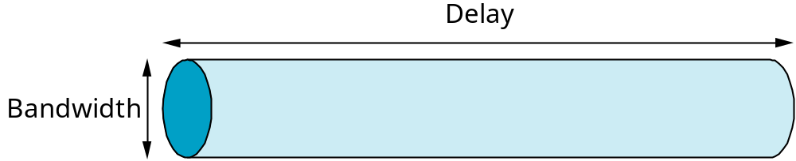
Delay x Bandwidth Product
Amount of data “in flight” or “in the pipe”
Usually relative to RTT
Example: 100ms x 45Mbps ≈ 560KB
MU CS 4850/7850

Slide 40
Other Metrics
Application’s bandwidth need
  VBR (variable bit rate) vs CBR (constant bit rate)
Delay jitter
  Buffering
Reliability, packet loss rate
Efficiency/overhead of implementation
MU CS 4850/7850

Slide 41
Implementing Network Software
Socket API
Creating a socket
  int socket(int domain, int type, int protocol)
    domain = PF_INET, PF_UNIX
    type = SOCK_STREAM, SOCK_DGRAM, SOCK_RAW
Active Open (on client)
  int connect(int socket, struct sockaddr *addr, int addr_len)
MU CS 4850/7850
Notes:
Domain: the protocol family.

Slide 42
Sockets (cont)
Passive Open (on server)
  int bind(int socket, struct sockaddr *addr, int addr_len)
  int listen(int socket, int backlog)
  int accept(int socket, struct sockaddr *addr, int addr_len)
Sending/Receiving Messages
  int send(int socket, char *msg, int mlen, int flags)
  int recv(int socket, char *buf, int blen, int flags)
MU CS 4850/7850
Notes:
Sockaddr in accept contains the remote participant’s address., accept returns a new socket that corresponds to the just-established connection.

Slide 43
Example: Simple Socket Program (Client Side)
/*build address data structure */
sin.sin_addr.s_addr = SERVER_IP_ADDRESS;
sin.sin_port=htons(SERVER_PORT);
…
/*setup active open */
s=socket(PF_INET, SOCK_STREAM, 0);
connect(s, (struct sockaddr *)&sin, sizeof(sin));
/*send text */
send(s, buf, sizeof(buf),0);
close(s);
MU CS 4850/7850

Slide 44
Example: Simple Socket Program (Server Side)
/*build address data structure */
sin.sin_addr.s_addr = INADDR_ANY;
sin.sin_port=htons(SERVER_PORT);
…
/*setup passive open */
s=socket(PF_INET, SOCK_STREAM, 0);
bind(s, (struct sockaddr *)&sin, sizeof(sin));
listen(s, MAX_PENDING);
/*wait for connection, then receive and print text */
while(1){
new_s=accept(s, (struct sockaddr *)&sin, &len);
while (len=recv(new_s, buf, sizeof(buf),0)) fputs(buf, stdout);
close(new_s);
}
MU CS 4850/7850

Slide 45
Introduction
Summary:
  Applications and Features
  Statistical Multiplexing
  Inter-Process Communication
  Network Architecture
  Performance Metrics
  Implementation Issues
MU CS 4850/7850

